Slide 1




Human resources slide 1

Slide 2



Who we are?
Customers
Mission Statement
Delighted Customers, Proud Employees
Integrity
Innovative
Intellect
synergy circle
Vision Statement
To maximize value for customers by delivering high quality solutions and services; driven by Intellect, Innovation and Integrity; in a fun, and healthy environment
Stakeholders
Employees
© 2025 Infinite Confidential

Slide 3

01
CORPORATE
OVERVIEW

Slide 4








Infinite Corporate Overview
Established in 2001
Headquarters in Rockville, MD, US & Bangalore, India.
100 M
2 M
600+ Fortune 1000 Customers
SI Consumers
Government
Veterans
Delivering a seamless digital transformation for our
customers
20K+ Global Employees
Touching over 50% of American lives!
80 M
149 M
Diverse, digital ready workforce aligned to a common purpose of consistently delivering excellence
Healthcare
Patients
Telecom
Subscribers
30% Annual Growth
$1.3B FY25 Forecast global annual revenue
149 M
54 M
20+ Global Offices
Transportation
Drivers
Media &
Entertainment
Platforms
& Products
BrassRing TM
BrassRing
Platform

Slide 5
Our Values - I-N-F-I-C-S
Infinite instils a strong sense of values amongst employees through the spirit of where each letter has a strong meaning.
IGNITE
NURTURE
FOSTER
Thought, leadership, passion
and innovation
A positive and creative environment for the holistic development of human capital.
Freedom of thought,
expression and action.
INSPIRE
CHALLENGE
SUPPORT
Integrity and strength of character in interactions with customers.
I, the individual and we, the team, to achieve excellence.
Social causes through compassion and collaboration.
© 2025 Infinite Confidential

Slide 6












STRENGTH OF A COMBINED ENTITY
By coming together Zyter TruCare and Infinite can now offer you services and products across your IT enterprise ecosystem.
APPEALS AND GRIEVANCES
POPULATION HEALTH MANAGEMENT
UTILIZATION MANAGEMENT
MEMBER ELIGIBILITY
DISEASE MANAGEMENT
MEDICAL MANAGEMENT
CARE MANAGEMENT
ENTERPRISE EDI SOLUTIONS
IT SERVICES/SUPPORT & STAFF AUGMENTATION
PAYER INTEROPERABILITY
AUTOMATION AND INTEROPERABILITY
CLAIMS & ENCOUNTERS

Slide 7












KEY BUSINESS AREAS
Talent BrassRing Platform
PLATFORMS
IoT
Healthcare solutions
Healthcare & Lifesciences
Telecom Solutions
Telecom, Media & Entertainment
Energy, Resources
& Utilities
Retail & Consumer
Packaging Goods
Hi-Tech & Manufacturing
Banking, Financial Services & Insurance
Travel, Transportation,
Hospitality & Logistics
Public Sector & Government

Slide 8











































































600+ F1000 CUSTOMERS
HEALTHCARE
Oregon and Utah
Idaho and Washington
TELECOM, MEDIA & ENTERTAINMENT, RETAIL, SPORTS
HI-TECH
BFSI
TRANSPORTATION & ENERGY
GOVERNMENT
Military Health
System

Slide 9



















































50+ Partner Ecosystem
TECHNOLOGY PARTNER
9

Slide 10
We are a global organization providing services from 25+ Delivery Centers –
5 Strategic Locations for Health System Support Services
London
Corporate Headquarters
Toronto
Global Delivery Centers
Munich
Boston
Prague
Chicago
Las Vegas
Dallas
Washington DC
Atlanta
Dehradun
Noida
New Delhi
Nepal
Gurugram
Merida
Jamaica
Hong Kong
Pune
Hyderabad
Visakhapatnam
Philippines
San Jose, Costa Rica
Panama City
Bangalore
Singapore
Chennai
Colombia
Malaysia
5 Strategic Locations supporting a Global Delivery Model
USA
India
Philippines
Jamaica
Colombia
Compliance and customer-sensitive work
Bilingual capabilities
Work-at-home solutions
Population health management solutions
Purpose-built provider engagement tools
22+ years of strong back-office experience
Ability to handle blended transactions
Advanced automation and analytics capabilities
Healthcare Practice office CoEs
Strong customer service support center
Excellent affinity with US culture
High end clinical capabilities
Well educated and deep nursing talent pool
English-speaking workforce
Excellent affinity with US culture and time zone compatibility
Strong customer service skills
College-degree labor force available
Spanish-speaking, bilingual
Highly committed and tenured workforce
Capability of handling
high-end work
DR location for customer service

Slide 11


IMMIGRATION
    For any and all immigration questions and concerns please reach out to immigration@infinite.com.
    Niti Prothi – SVP of HR handles all Immigration details and documents.

Slide 12






EMPLOYEE ENGAGEMENT
1
Other Benefits
Service helpdesk for Employees
Personal growth plans
Open culture and team building activities
Benefits @Infinite
Salary, Performance-linked Bonus
Benefits
Vacation ( linked to tenure) / Sick Leave
5
2
Tenure Protection
Job Rotation Plan / Global Opportunities
Career Path
Competency Development
Leadership Training and Touchpoints
Rewards and Recognition for Employees
Technical and Soft skills development programs through Infinite Learning Academy
4
3
Work Life Balance

Slide 13

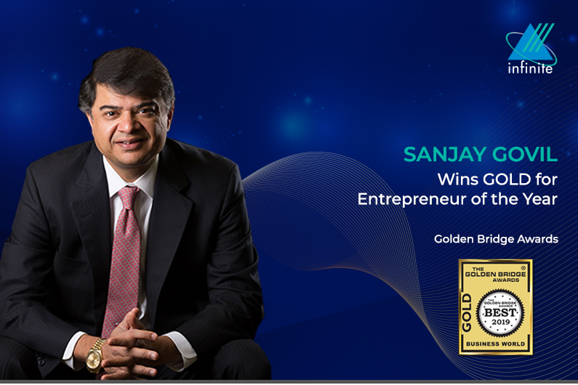
INFINITE LEADERSHIP AWARDS

Slide 14

02
POLICIES

Slide 15

POLICIES
Work Place Behavior
    Infinite expects employees to strive to maintain and contribute to their reputation. This includes treating others respectfully, communicating clearly, and projecting a positive attitude and professional demeanor at all times.

Slide 16
POLICIES
Dress Code
    Infinite expects employees to be dressed appropriately and be well groomed on a daily basis.
    At corporate offices, all employees may dress in classic business or business casual attire. On client sites, the client practices should be followed.
    Visible tattoos need to be covered up at all times, especially when attending client meetings or at a client locations.

Slide 17
POLICIES
ILLEGAL ACTIVITIES
Engaging in illegal activities can lead to termination.
Employees are expected to maintain high level of confidentiality with the Company and client data.
CONFIDENTIALITY / NDA
EMPLOYEE BACKGROUND
VERIFICATION
Employee background verification is done through an external agency and any misrepresentation would be treated as misconduct.
DATA SECURITY
It is mandatory for all the employees to be thorough with our security policy. Any breach will lead to disciplinary action or termination.

Slide 18





LIFE @ INFINITE : WORK ENVIRONMENT
Provide a safe, healthy workplace free from any harassment.
Report any suspected harassment, any unwelcome acts at workplace, helping sustain a healthy work environment or fraud to Management or H.R.
It's not about intent. It's about impact.

Slide 19

03
TIME SHEET &
PAYROLL OVERVIEW

Slide 20

TIME SHEET & PAYROLL
Attendance for all Infinite employees is tracked through a web-based Time Management System (TMS).
You will be notified regarding your User ID and password to access TMS within your first week of employment. Until you receive your login information you will need to complete a manual timesheet.
TMS can be accessed through BizX at https://bizx.infinite.com/bizx/home
The best browser to use is Google Chrome.
The BizX Timesheet allows employees to complete their timesheets for the current two-week payroll period.
Missed hours can be logged by contacting USPayroll@infinite.com
HR does NOT handle timesheets or payroll.

Slide 21
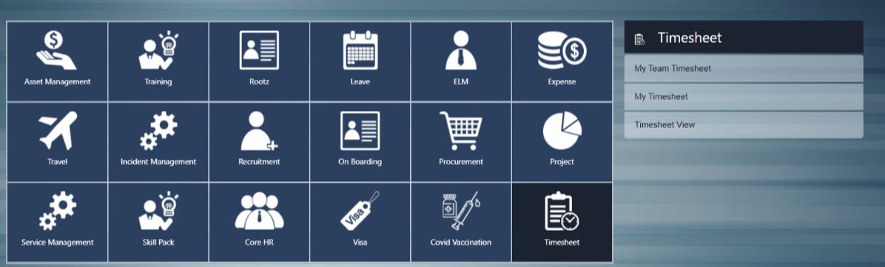
Timesheet in BizX
Once you log in to BizX, Click on the “Timesheet” icon, then click “My Timesheet”.
https://bizx.infinite.com/bizx/home

Slide 22
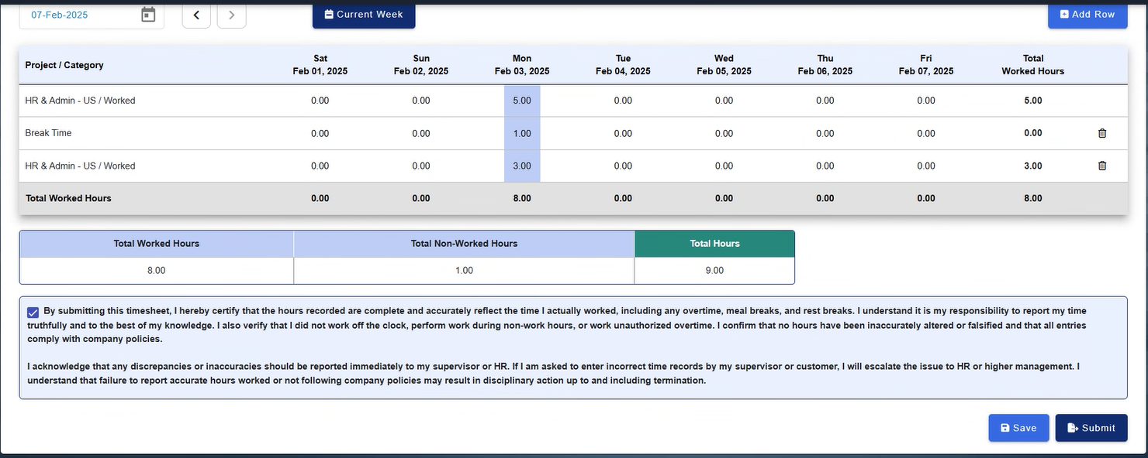
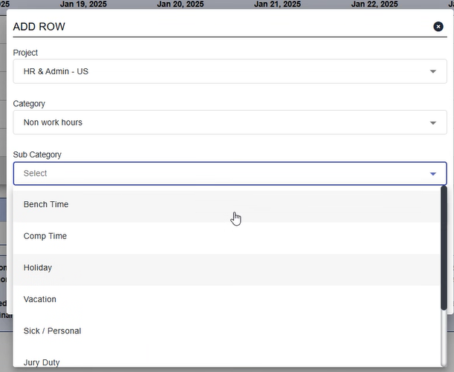
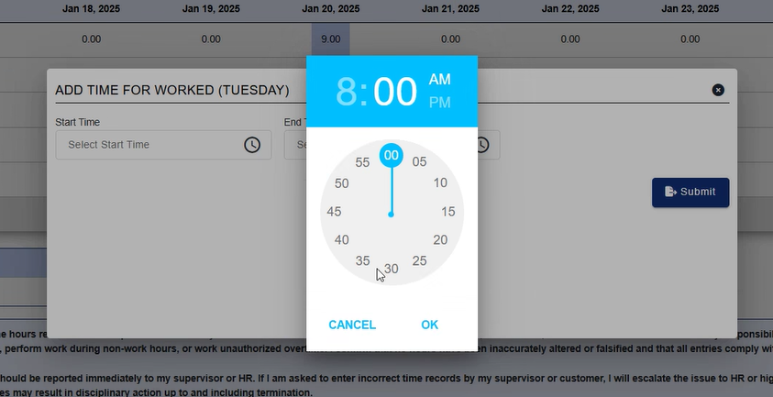
Note: If you take a break, you must add in break time as they are unpaid.

Slide 23
TIME SHEET & PAYROLL
Payroll is bi-weekly and pay dates are typically on Fridays. We have 26 pay periods per year.
A payroll calendar is included in New Hire Packet 3
ALL employees must submit their time by the payroll deadline shown on the payroll calendar
Please note that you CANNOT enter your hours in advance
The TMS will lock after the cut off period (Monday 11:00 AM EST).
If your time is not submitted by the close of the payroll period, you may experience pay delays.
Time can be handwritten onto the form or typed in, but MUST be signed before submitting it to Payroll!
If you have any questions, please contact USPayroll@infinite.com.
First payment will be Direct Deposit.

Slide 24
TIME SHEET & PAYROLL
Infinite utilizes an online pay stub system through ADP
To view your pay stubs online, you will need to sign up for an ADP iPay account using your personal email address.
An information flier and registration instructions can be found in your on boarding email – New Hire Packet 3
Once registered, you can view current or previous paystubs, as well as W2s online.
You will also be able to view your leave balances.

Slide 25
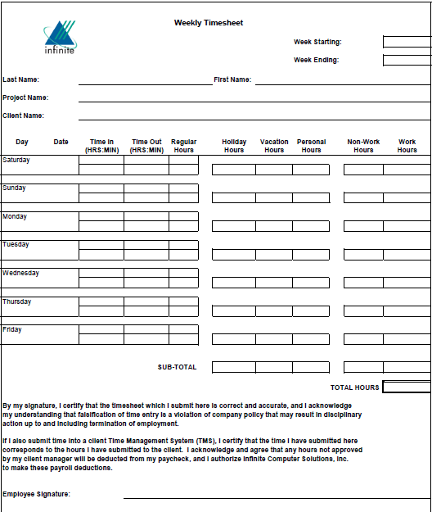

Slide 26

04
BENEFITS OVERVIEW

Slide 27
BENEFITS
“ADP” is our online enrollment tool. The site can be accessed at https://workforcenow.adp.com.
The attachments in New Hire Packet 3 will help you prepare for and complete the online enrollment process.
Enrolling in coverage is required to be captured within the first 30 days of employment.
Your benefits will be effective retroactive to your first day of employment.
Your enrolled benefits will end on your last workday.

Slide 28
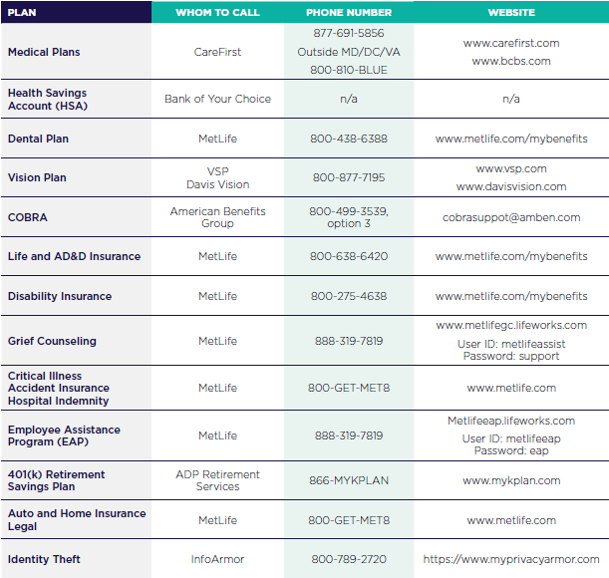
Benefit Carrier Information

Slide 29
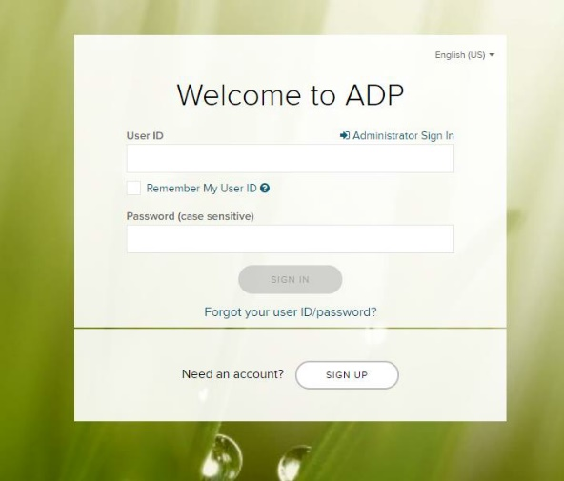
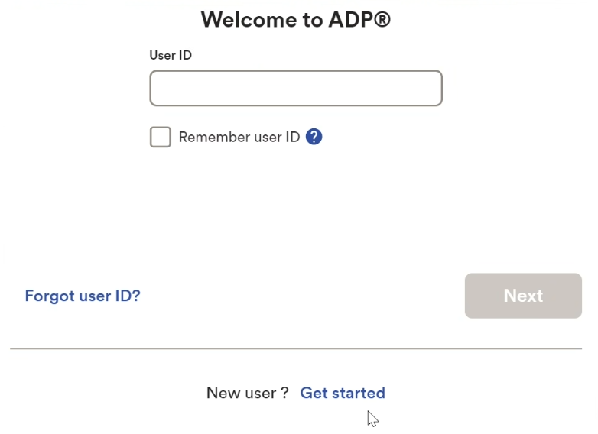

https://workforcenow.adp.com

Slide 30
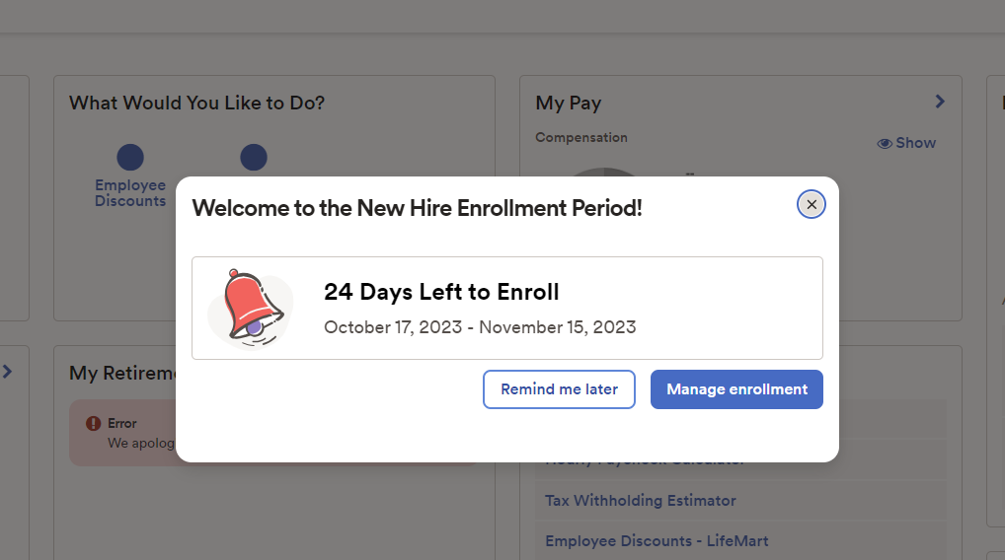


Once you have logged into ADP you will receive a pop-up to begin your enrollments. You can click “Manage enrollment” to start or “Remind me later” to wait.

Slide 31
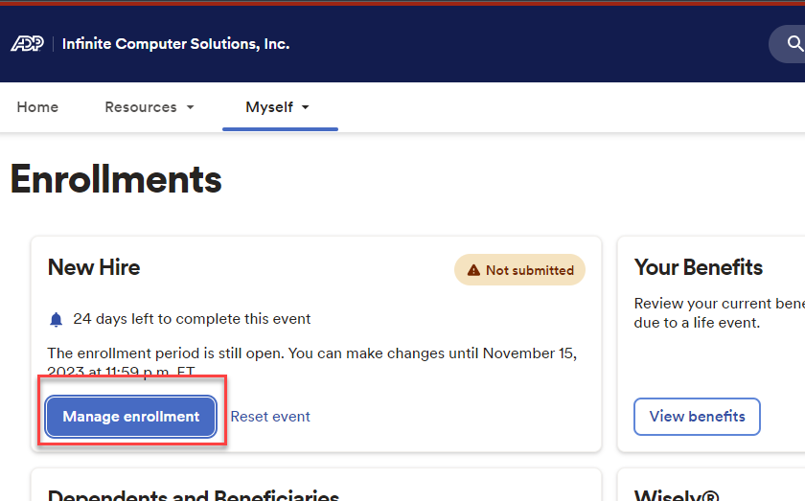
Click Manage enrollment to start

Slide 32
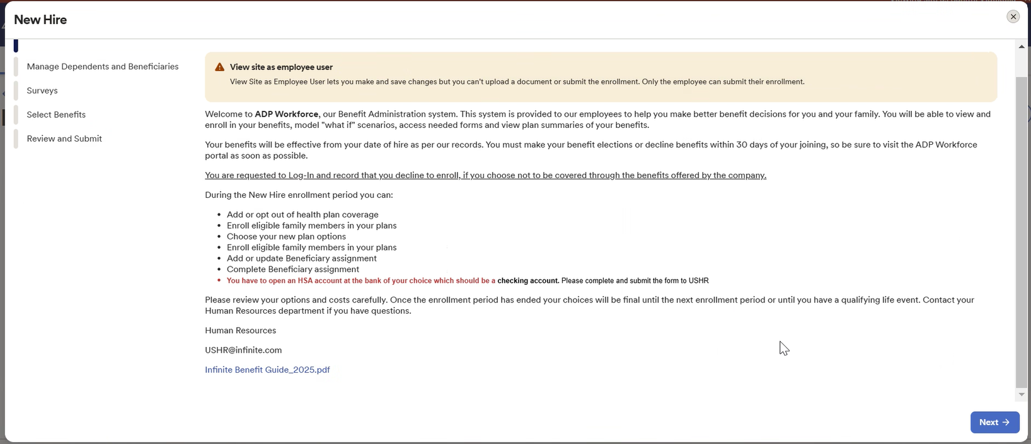
Please review the welcome message and download the Benefits guide

Slide 33
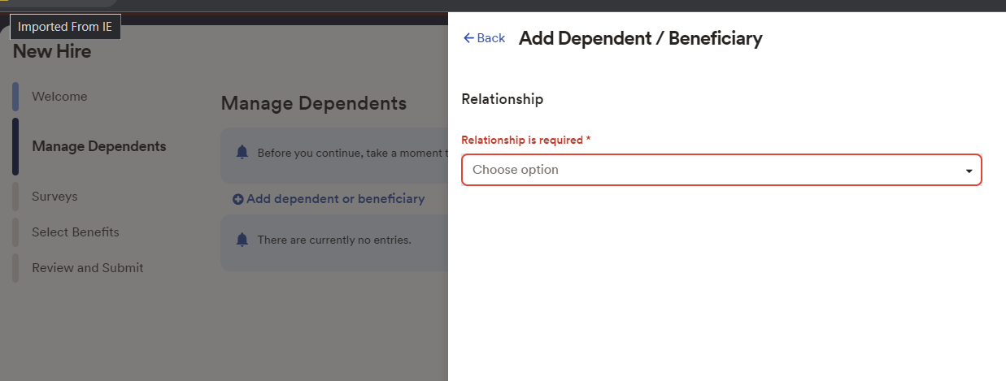
You will be required to add any dependents/beneficiaries.

Slide 34
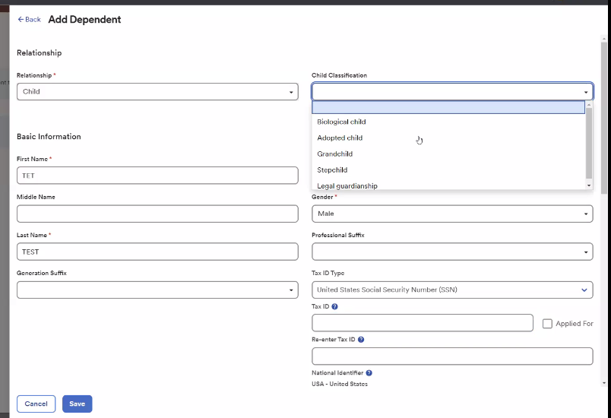
Name, Date of Birth, Gender, SSN are required fields for dependents and beneficiaries.

Slide 35
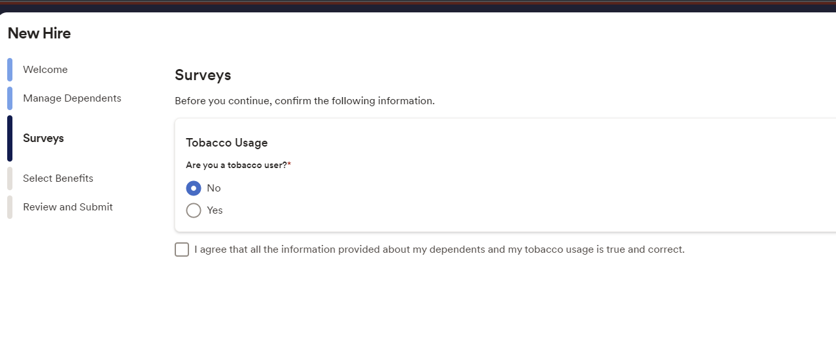
You will be required to select tobacco user and select the agree box

Slide 36
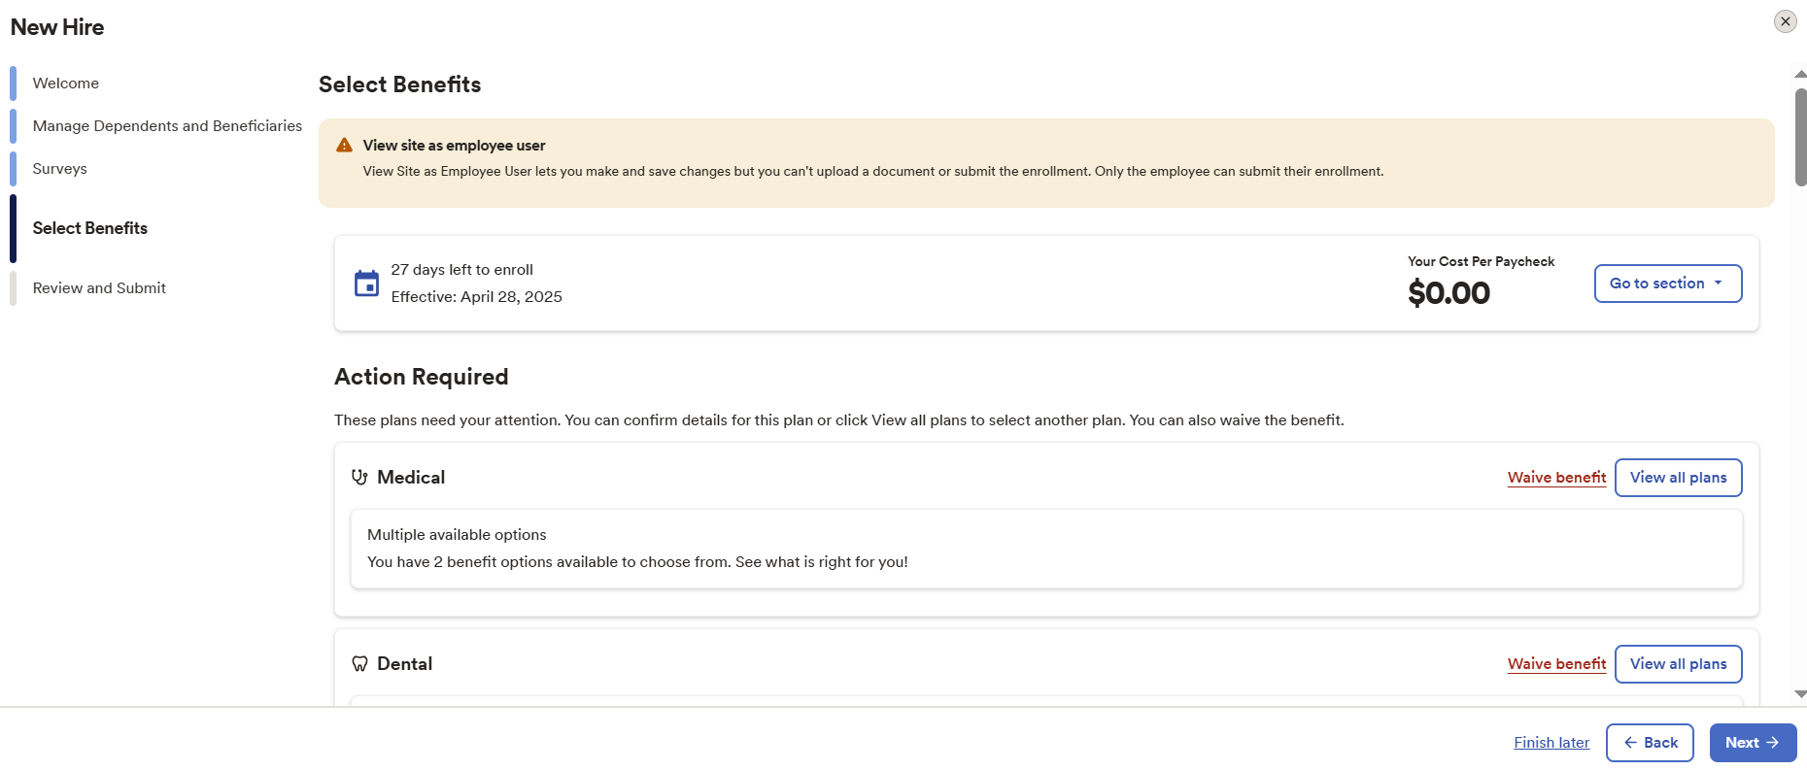
You will view the plans to select the coverage level. If you decide to waive a plan you will be required to give a waive reason from the dropdown.

Slide 37
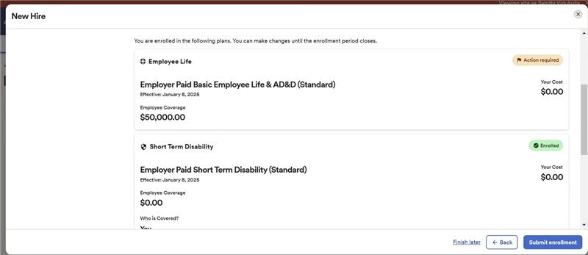
Once you have selected the benefits for your needs, you will select “submit enrollment”. If “submit enrollment” is not clicked, you will not be enrolled.
You can always go back to update your enrollments within the 30-day New Hire window.

Slide 38
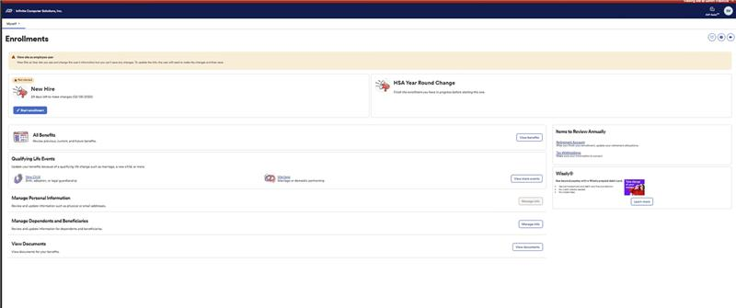
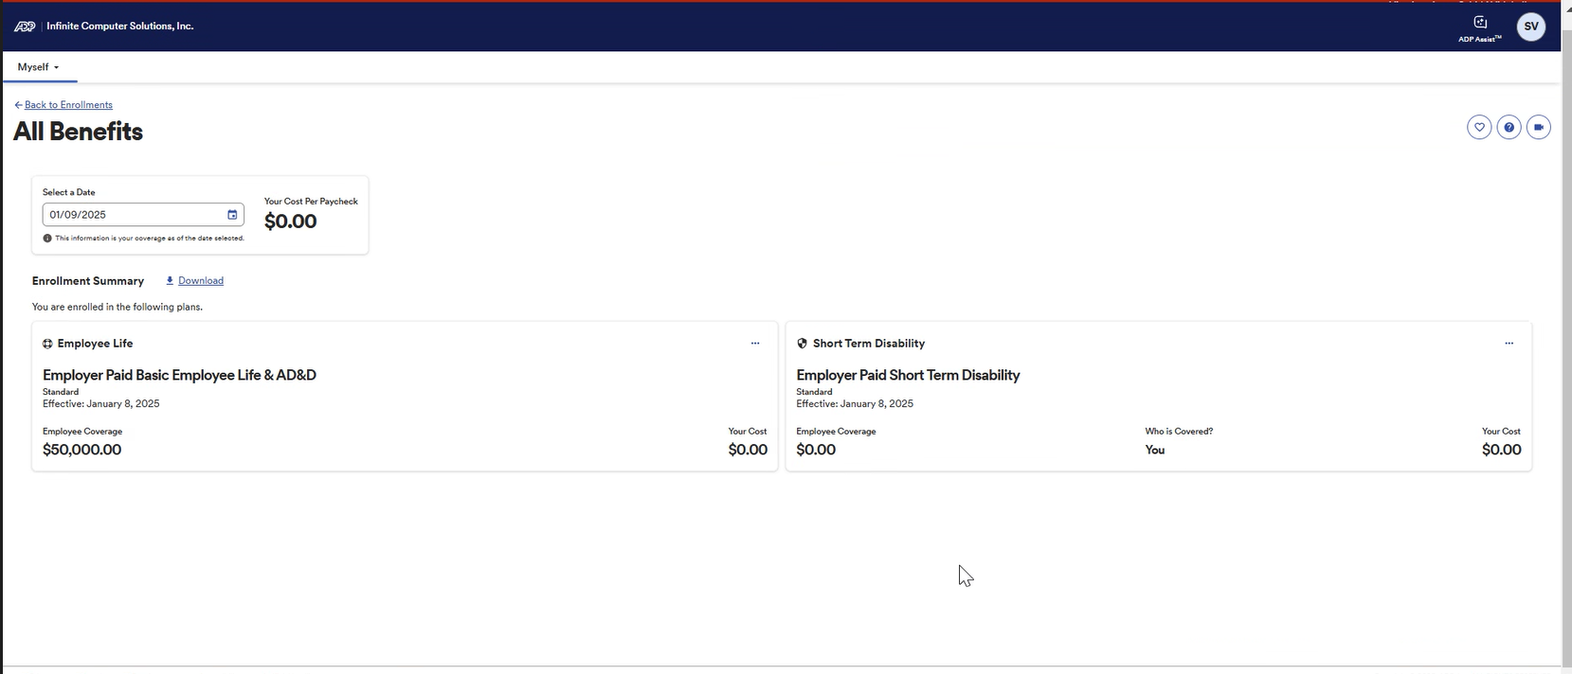
To view your completed enrollment, please select
Myself/View Benefits/Enrollments
You can also download your Enrollment Summary here as well.

Slide 39
Qualifying Life Events
Once your benefit elections become effective, they remain in effect until the end of the calendar year unless
you become ineligible for the benefit or have a Qualified Life Event.
QUALIFYING LIFE EVENTS
Generally, you may only make or change your existing benefit elections during the open enrollment window.
However, you may change your benefit elections during the year if you experience an event such as:
 Marriage
 Divorce or legal separation
 Birth of your child or your domestic partner’s child
 Death of your spouse, domestic partner or dependent child
 Adoption of or placement for adoption of your child
 Change in employment status of employee, spouse/domestic partner or dependent child
 Qualification by the Plan Administrator of a child support order for medical coverage
 Entitlement to Medicare or Medicaid
You must notify Human Resources within 30 days of a qualifying life event. Depending on the type of
event, you may need to provide proof of the event, such as a marriage license. Human Resources will let you
know what documentation you should provide. If you do not contact Human Resources within 30 days of
the qualified event, you will have to wait until the next open enrollment window to make changes (unless you
experience another qualifying life event).

Slide 40

401k – Retirement Plan
Everyone will be eligible to enroll into the 401k plan after the 1st of the month, of the upcoming quarter from the date that you were hired.
  EXAMPLES
    January 1st – March 31st – Eligible April 1st.
    April 1st – June 30th – Eligible July 1st.
    July 1st – September 30th – Eligible October 1st
    October 1st – December 31st – Eligible January 1st.
You will receive the information packet from ADP in the USPS mail near the time of your eligibility date.
Any questions regarding your plan/contributions please reach out to ADP 401k directly @ 1-866-MYKPLAN.
Any questions regarding rollover, please reach out to Niti.Prothi@infinite.com.
The company does not match.

Slide 41
Benefits Recap
Your 30 – Day New Hire window begins on your FIRST day of employment. Benefit Enrollment must be completed in ADP Workforce Now, and no one is automatically enrolled.
Benefits are RETROACTIVE to your FIRST day of employment.
If you enroll in one of our medical plans, you will receive your card within 4 weeks after your enrollment is complete. You will also be eligible for the HSA plan at this time.
All HSA Accounts must be CHECKING accounts.
If you do not click “Submit Enrollment” your benefit elections will not be captured.
There are NO cards for Dental and Vision. If you enrolled in these benefits, provide your SSN to the provider and they will be able to locate you in the system.
401K Eligibility – The first of the following quarter after your joining date. The companies do not match.

Slide 42

05
TRAVEL
OVERVIEW

Slide 43

TRAVEL
It is mandatory for the Employee to use the company approved travel agents for all travel reservations.
Air travel will be charged to Infinite’s Corporate Credit card.
Reference Travel policy documents :
Travel Policy
Travel Guidelines
Expense reimbursement policy

Slide 44
TRAVEL
Instructions for Raising Travel Request
  Log into BizX website @ https://bizx.infinite.com/
  Click on “Travel”. Then “Travel Request”
  Fill in every section with a Red *
  Fill in “Accommodation Reservation” if Hotel is needed, if not needed “Click” on “Not Required”
  Fill in Food Preference
  Fill in Seat or Aisle
  Click at bottom on “Submit”
  Send your TR100XXX to travel@earthlink.net

Slide 45
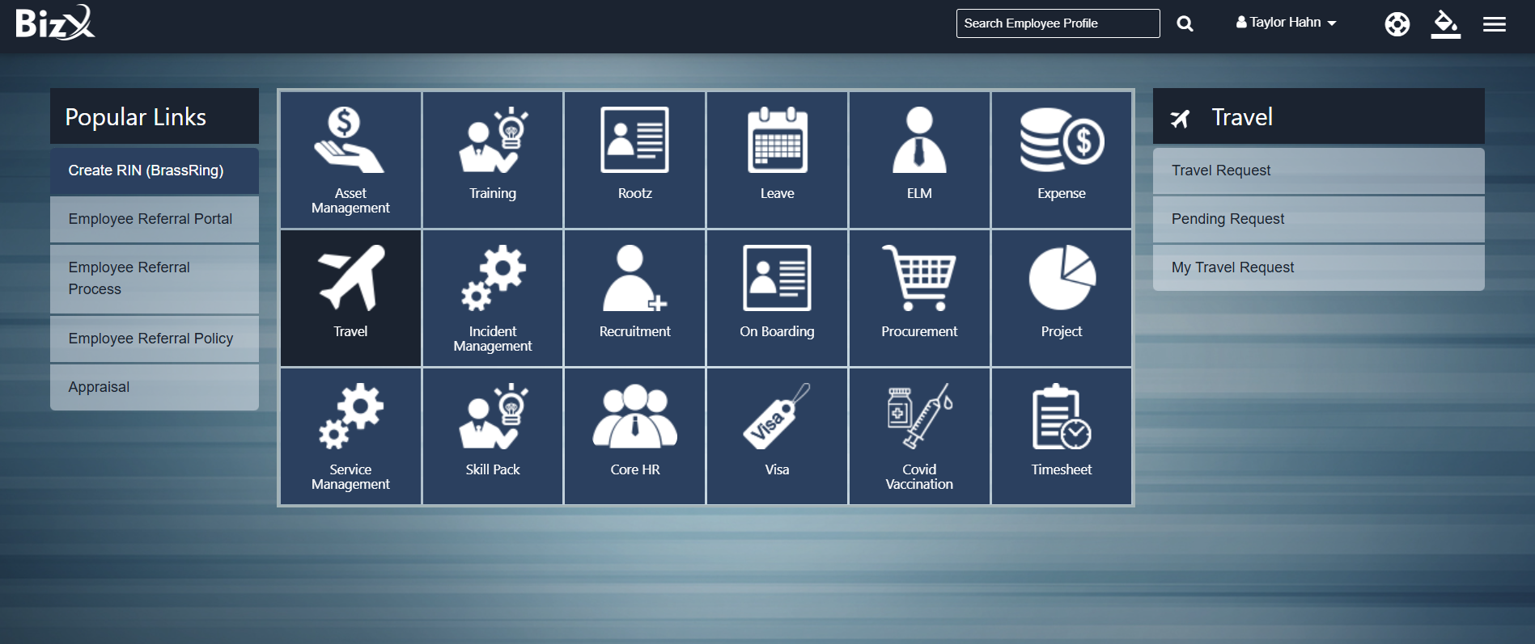
TRAVEL

Slide 46
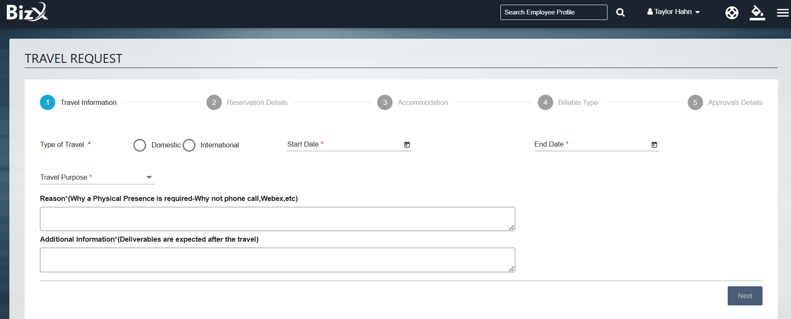
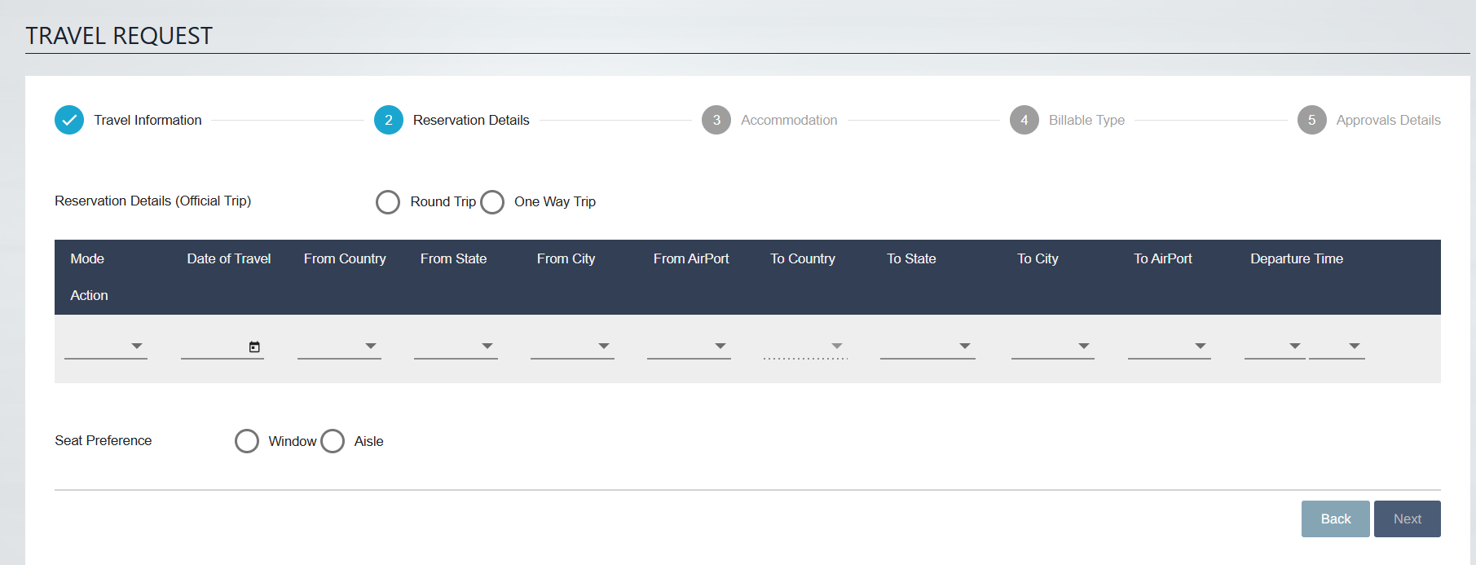
TRAVEL

Slide 47

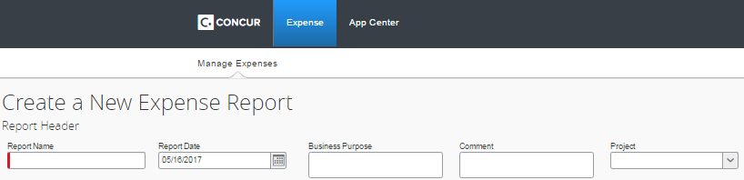
EXPENSE REIMBURSEMENT SCREEN SHOT OF CONCUR
To request Concur credentials please send an E-mail to your Infinite Manager.
  Step-1 :- Please click on Start a Report to update your expenses.
Step-2 : Update your report name, report date, business purpose, comment and project
Step-3 : By selecting “Expense Type”, please update your expenses and submit

Slide 48
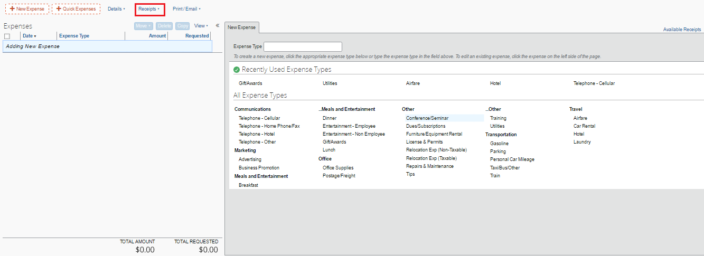
SCREEN SHOT OF CONCUR
Note: All expenses need to be submitted in Concur with in 2-weeks of returning from travel. All expenses submitted and approved by Monday COB of the Non-Payroll week would be reimbursed in the forthcoming Payroll. Any expenses submitted beyond the Non-Payroll Monday would be reimbursed in the Subsequent/Next Payroll. This is required to ensure that all the expenses are thoroughly reviewed and analyzed.

Slide 49
REIMBURSEMENTS
Reimbursement claims received and approved by Monday COB of the Non-Payroll week would be reimbursed in the forthcoming Payroll
Reimbursements will be paid as per Company Policy
All reimbursements should be claimed through Concur (Online Tool ) along with the supporting documents
SLAs for Reimbursements
For Reimbursements

Slide 50

06
IMPORTANT FORMS & CONTACTS

Slide 51
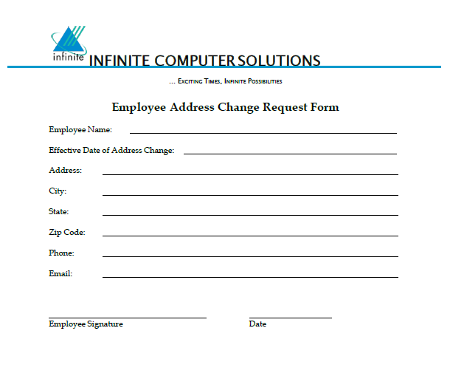
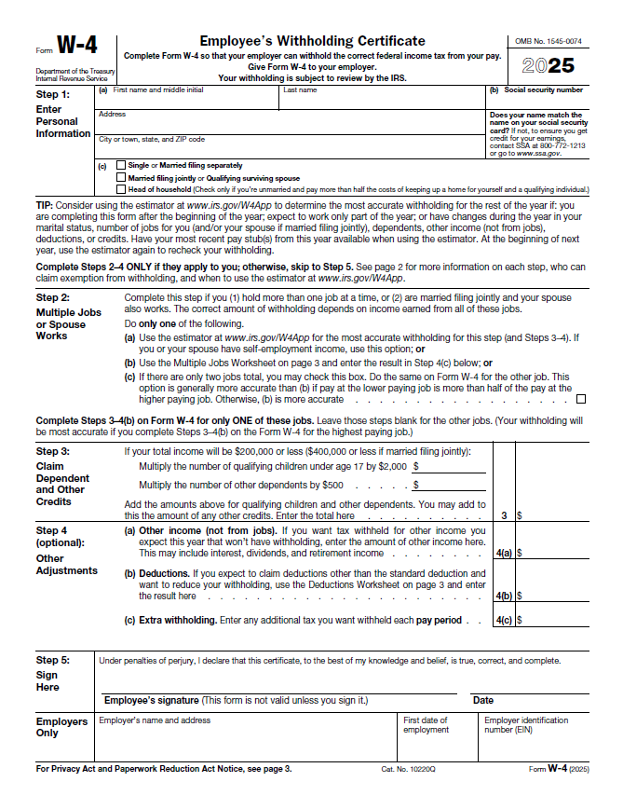
Address Change Request Form
W-4 Form

Slide 52
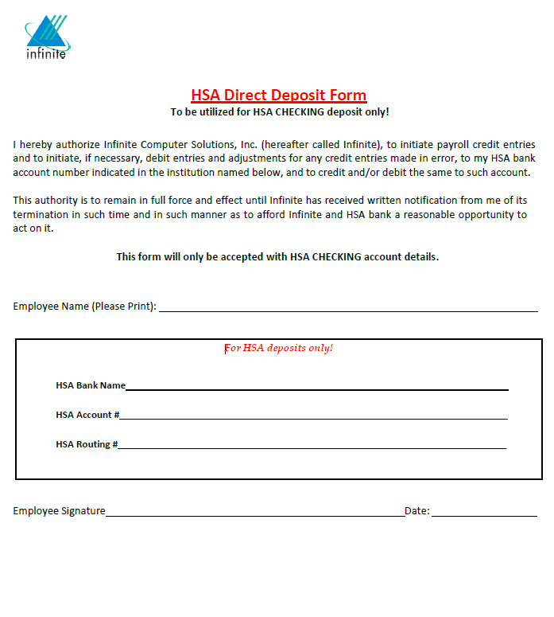
HSA Direct Deposit Form
Updating Your Direct Deposit
  Employees can edit their bank accounts details after receiving their first paycheck for payroll in the payroll portal ADP. Please follow the steps below to make any changes to your bank accounts:
  Log in to the ADP portal.
  Click on the “Myself” and select “Payment Options” from the dropdown menu.
  This will take you to the Bank Account Direct Deposit screen.
  Continue to edit or add your bank account details as needed.
  Please refer to the attached document with screenshots for further guidance
  If you have any questions on the above steps, please contact USPayroll@infinite.com

Slide 53
IMPORTANT CONTACTS DETAILS
For Email and BizX Credentials:
Email- ITSG-US@infinite.com
For Payroll & ADP Concerns, Time Sheet and Attendance, Reimbursements Concerns:
Email- USPayroll@infinite.com
Head of Payroll: Prabhu Hosamane, (301) 355-7724, Payroll Executive: Susmita Munda, (323) 325-5632
For Benefit Concerns:
USHR@infinite.com
For HR and General Concerns:
USHR@infinite.com

Slide 54

07
HUMAN RESOURCES

Slide 55
HR TEAM
Niti Prothi
(SVP- HR)
214-862-7845
Niti.Prothi@infinite.com
We are listening and
We care for you!!
USHR@infinite.com
HR@zyter.com
Harish Venkatesh (Senior Manager - HR)
(301) 355-7705 | Harish.Venkatesh@infinite.com
Tiffany Johnson (Senior Manager - HR)
(301) 355-7704 | Tiffany.Johnson@infinite.com
Franches Martin (HR Executive)
(301) 685-3458 | Franches.Martin@infinite.com
Sai Vasanth (HR Executive)
(413)741-3439| Sai.Vasanth@infinite.com
Ravi Govindarajulu (Assistant Manager)
(301) 238-4681 | ravi.kumar@infinite.com
Ajay Kumar (HR Associate Executive)
(240) 428-6411 | Ajay.Kumar4@infinite.com
Priyadarshan Raghul (HR Executive)
(413)741-3414| Priyadarshan.Raghul@infinite.com
(
Taylor Rasberry (Senior HR Generalist)
(301) 591-9718| Taylor.Rasberry@infinite.com
Rahamathulla Uthamanli
(HR Associate Executive)
(301) 355-7707 | Rahamathulla.Uthamanli@infinite.com
Prasanna Yadavan (HR Executive)
(413)440-0074| Prasanna.Yadavan@infinite.com
(
Shahil Sheik(HR Executive)
(301) 685-1013| shahil.sheik@infinite.com
Amarnath Meganathan (HR Executive)
(301) 880-3326 | amarnath.meganathan@infinite.com
Kranti Pedeni (HR Executive)
(413)334-1463| Kranti.Pedeni@infinite.com
Supriya Soundara (HR Executive)
(301) 355-2764| supriya.soundara2@infinite.com
Manohara Ramakrishna ( HR Executive)
(413)334-1269|Manohara.Ramakrishna@infinite.com
Sathish Sundharam (HR Executive)
(413)741-3576| Sathish.Sundharam@infinite.com
Lizbeth Sanchez (HR Generalist)
(301) 825-8541| lizbeth.sanchez@infinite.com
Uday Kumar (HR Executive)
(301) 355-0064 | uday.kumar4@infinite.com
Deepak Balraj(HR Associate Executive)
(413)238-9263| Deepak.Balraj@infinite.com
Margoth Diaz (HR Generalist)
(301) 355-7765| margoth.diaz@infinite.com

Slide 56


